Slide 1
PROJECT
T-SHIRT LANGUAGE

Slide 2
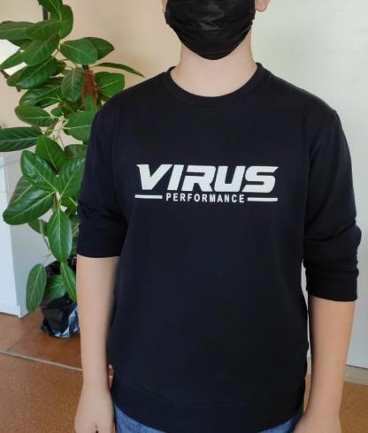
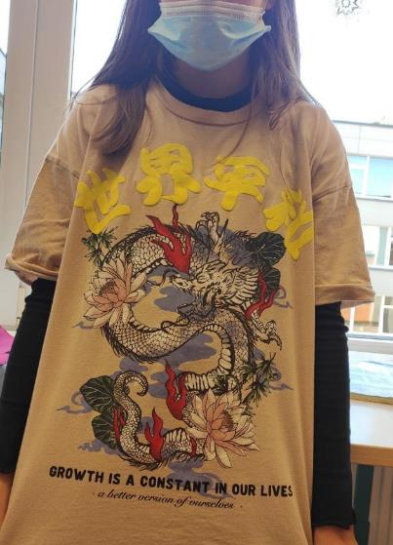
T-SHIRT LANGUAGE

Slide 3
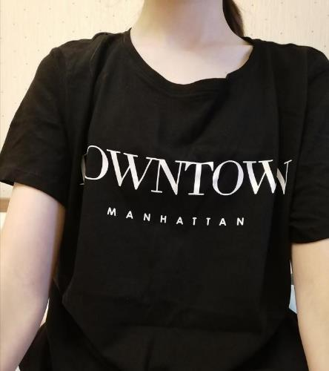
T-SHIRT LANGUAGE

Slide 4
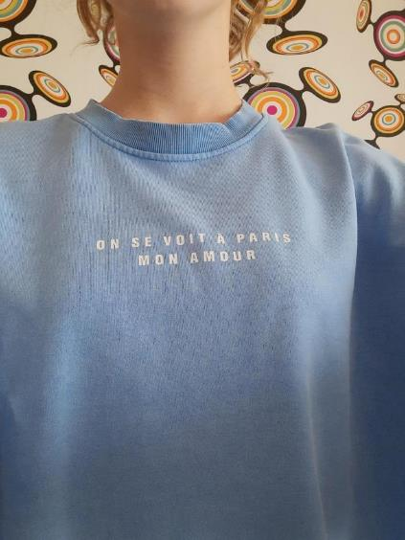
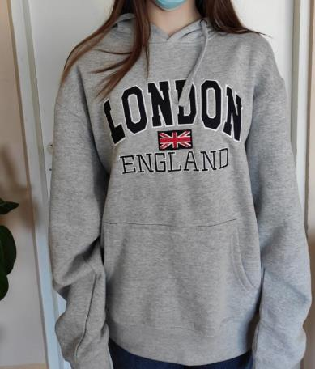
T-SHIRT LANGUAGE

Slide 5
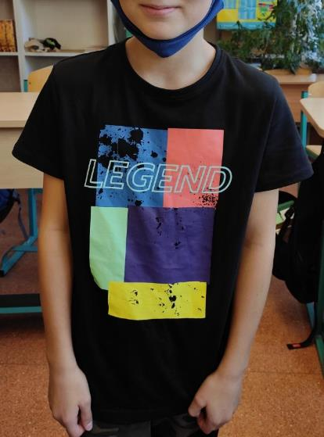
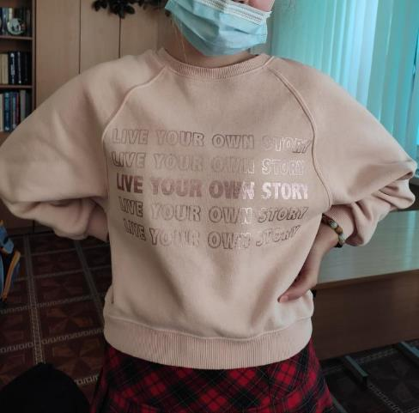
T-SHIRT LANGUAGE

Slide 6
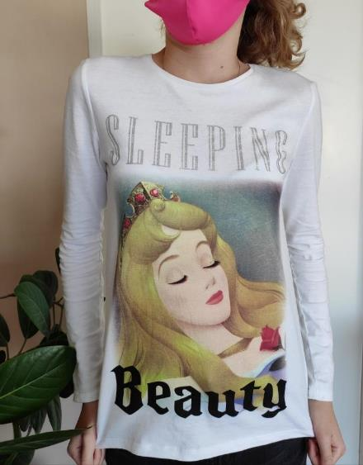
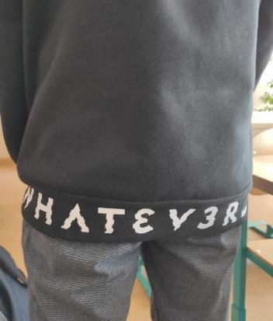
T-SHIRT LANGUAGE

Slide 7
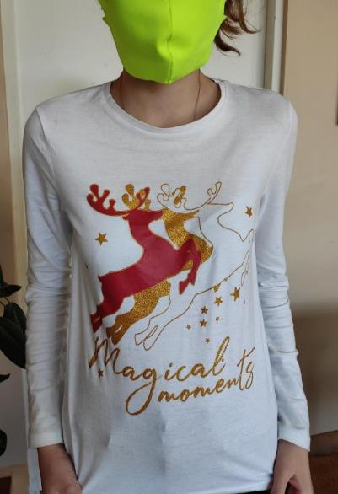
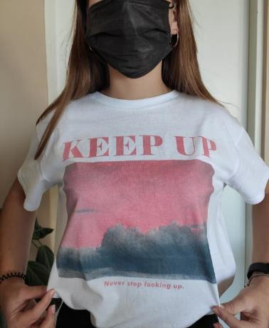
T-SHIRT LANGUAGE

Slide 8
T-SHIRT LANGUAGE

Slide 9
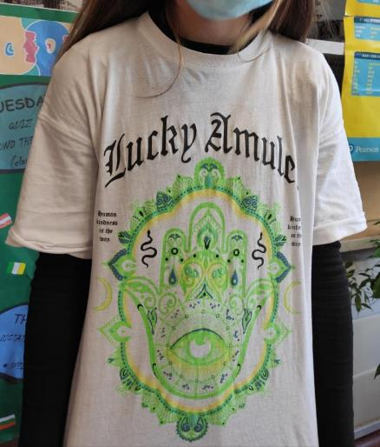
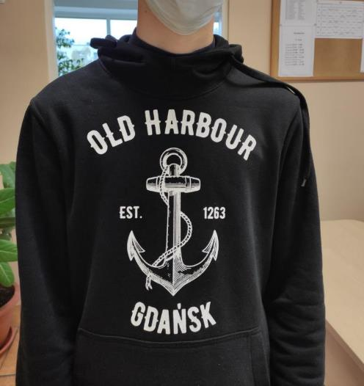
T-SHIRT LANGUAGE

Slide 10
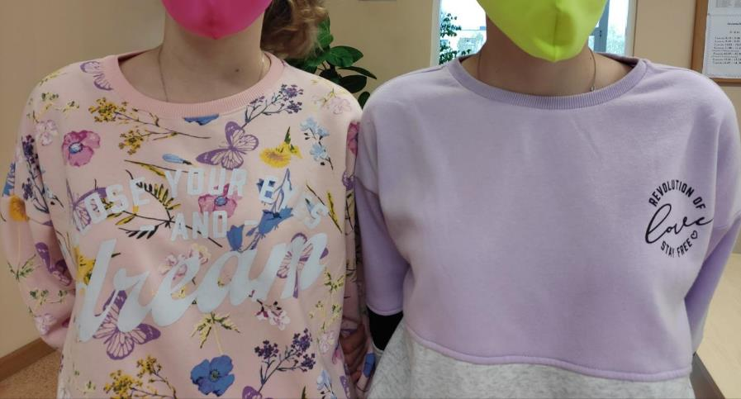
T-SHIRT LANGUAGE

Slide 11
T-SHIRT LANGUAGE

Slide 12
T-SHIRT LANGUAGE

Slide 13
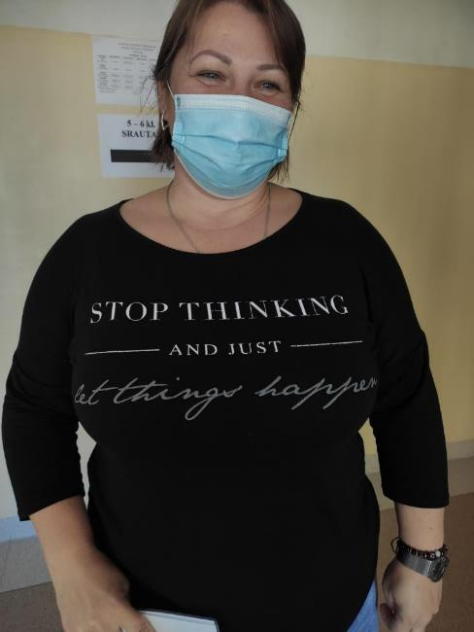
T-SHIRT LANGUAGE

Slide 14
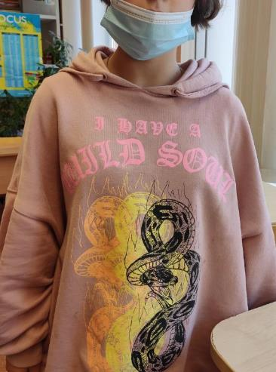
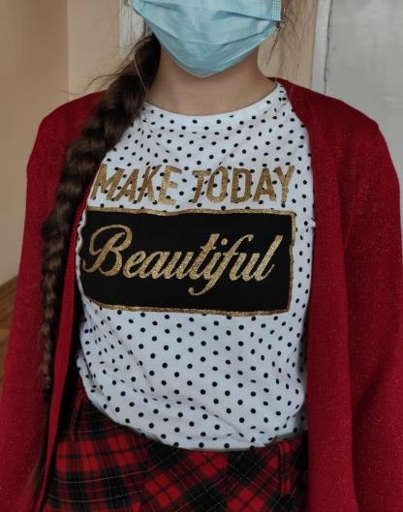
T-SHIRT LANGUAGE

Slide 15
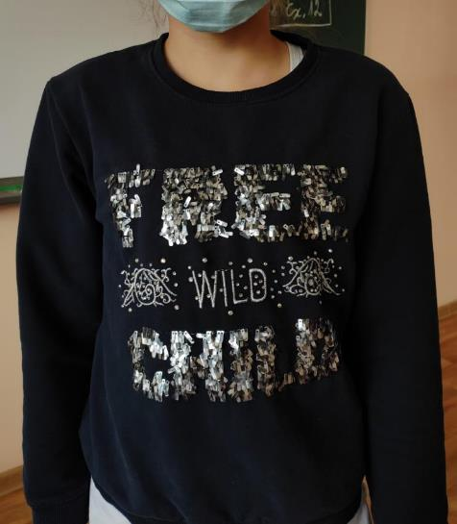
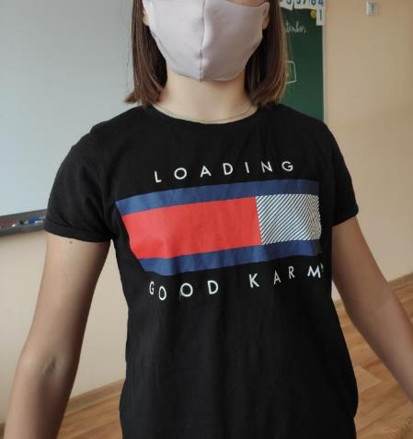
T-SHIRT LANGUAGE

Slide 16
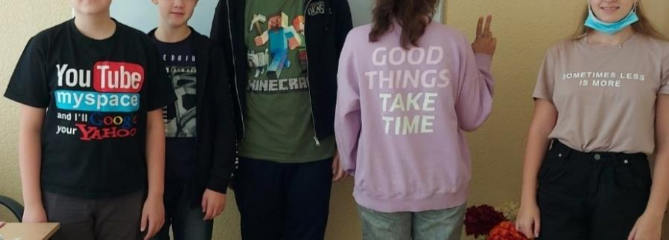
T-SHIRT LANGUAGE

Slide 17
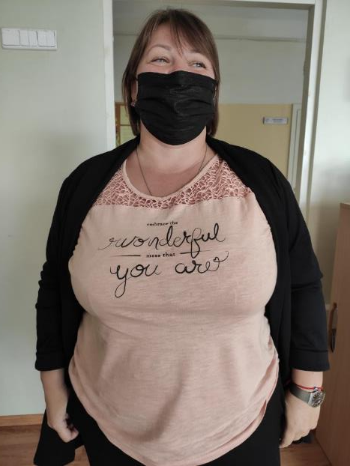
T-SHIRT LANGUAGE

Slide 18
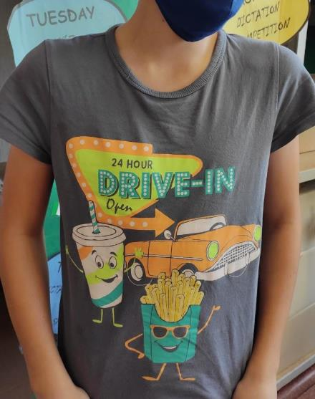
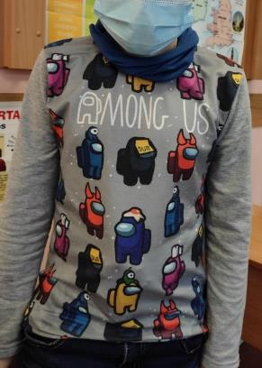
T-SHIRT LANGUAGE

Slide 19
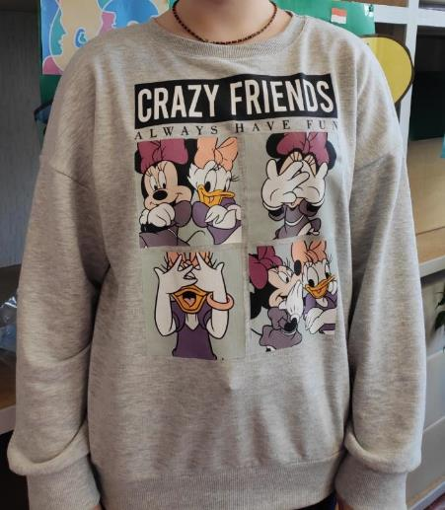
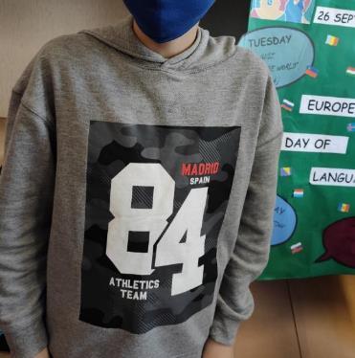
T-SHIRT LANGUAGE

Slide 20
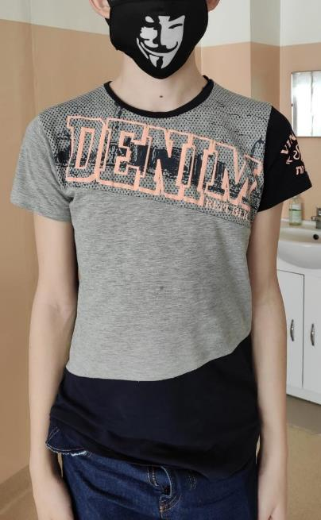
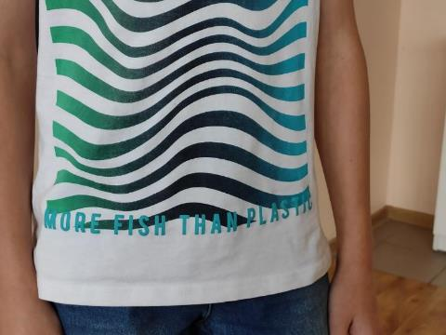
T-SHIRT LANGUAGE

Slide 21
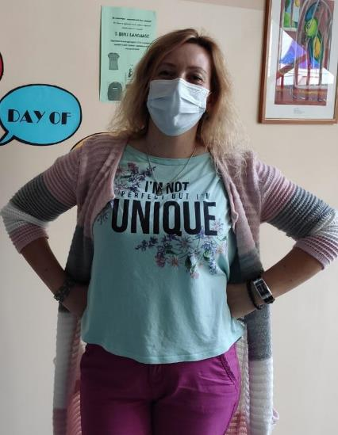
T-SHIRT LANGUAGE

Slide 22
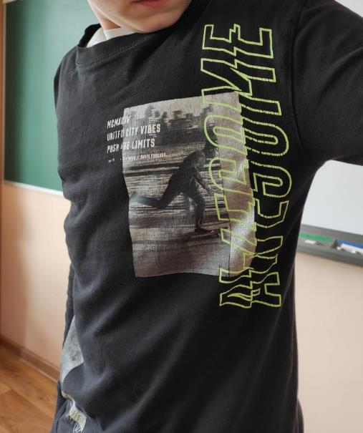
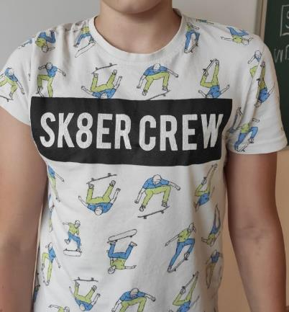
T-SHIRT LANGUAGE

Slide 23
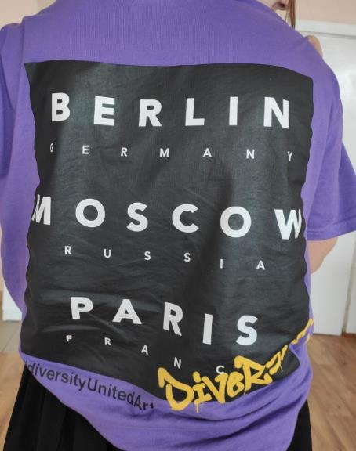
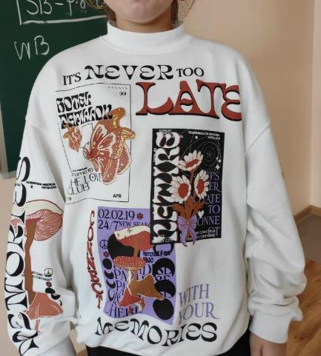
T-SHIRT LANGUAGE

Slide 24
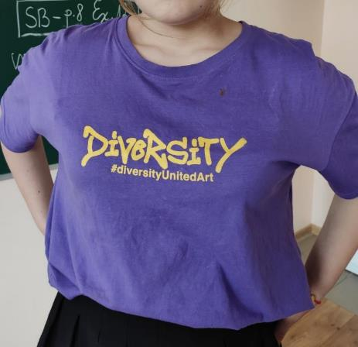
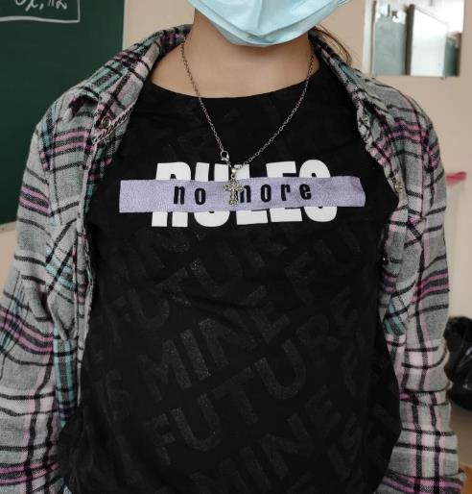
T-SHIRT LANGUAGE

Slide 25
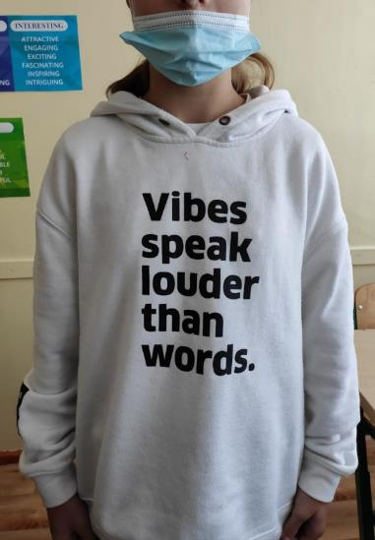
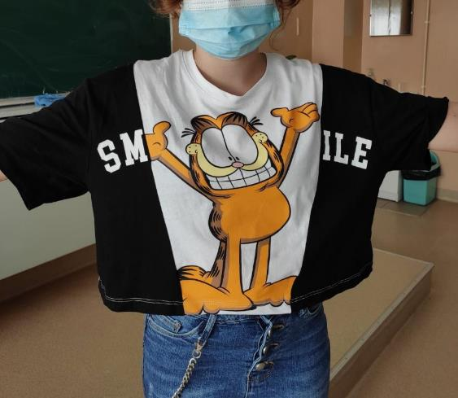
T-SHIRT LANGUAGE

Slide 26
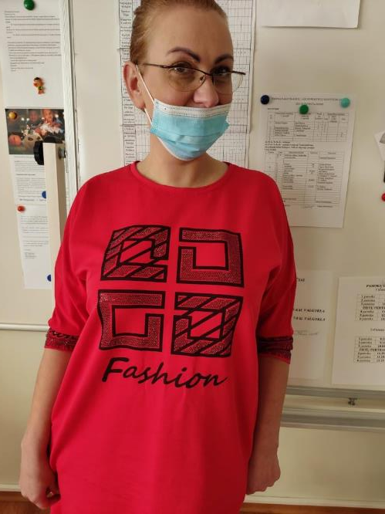
T-SHIRT LANGUAGE

Slide 27
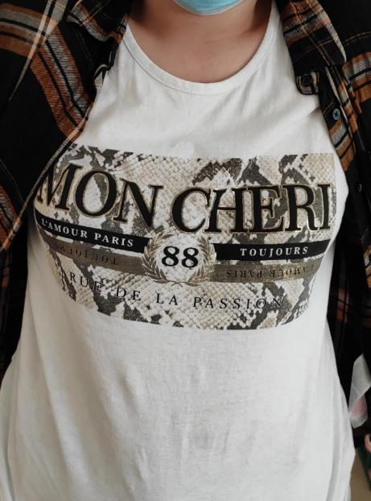
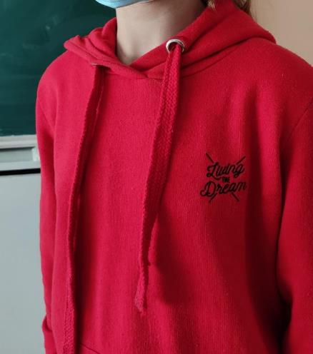
T-SHIRT LANGUAGE

Slide 28
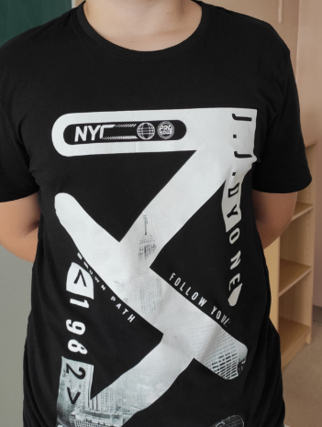
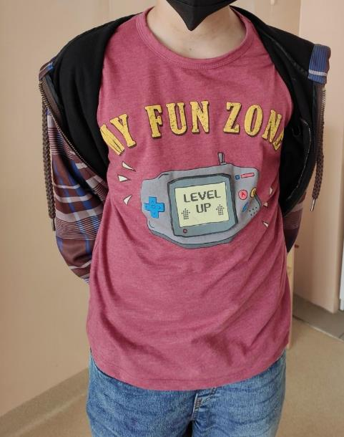
T-SHIRT LANGUAGE

Slide 29
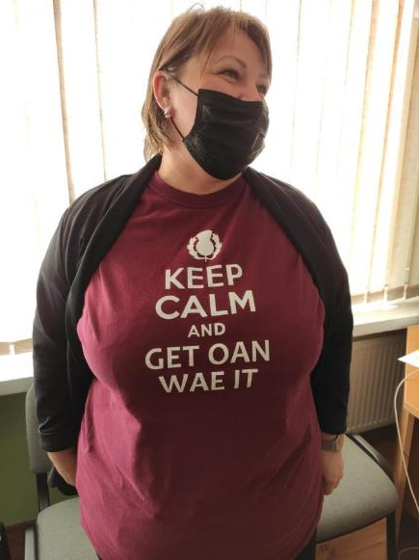
T-SHIRT LANGUAGE

Slide 30
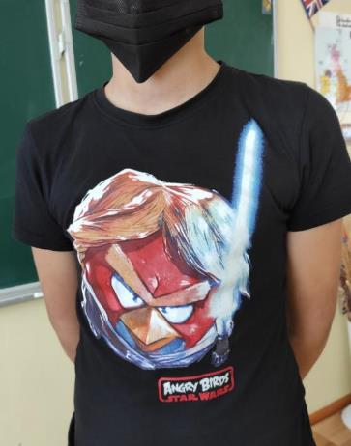
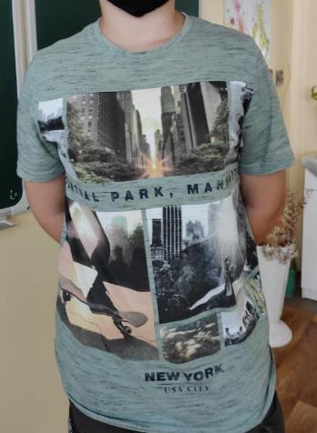
T-SHIRT LANGUAGE

Slide 31
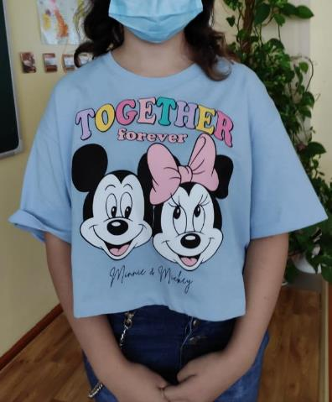
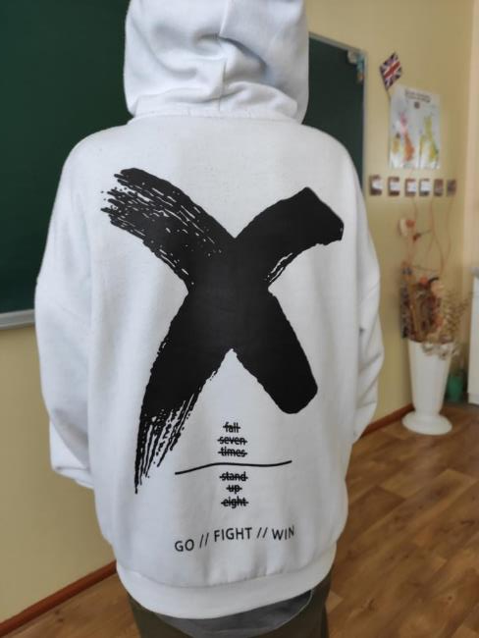
T-SHIRT LANGUAGE

Slide 32
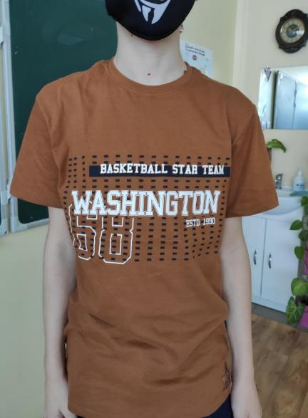
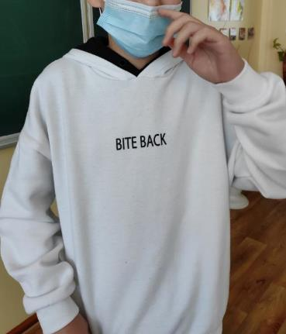
T-SHIRT LANGUAGE

Slide 33
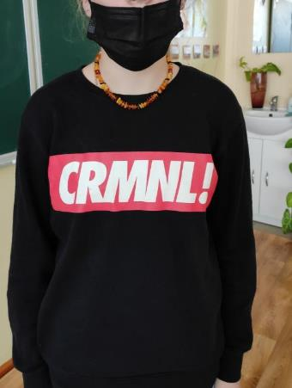
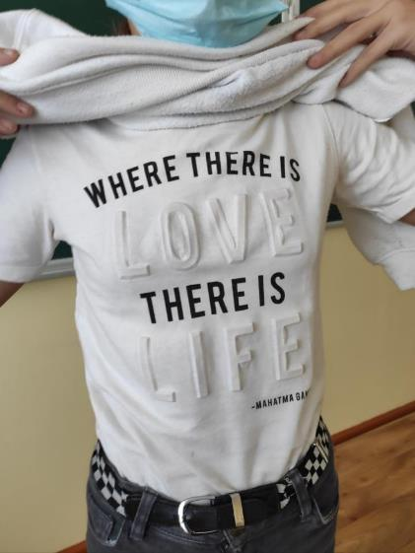
T-SHIRT LANGUAGE

Slide 34
T-SHIRT LANGUAGE

Slide 35
T-SHIRT LANGUAGE

Slide 36
T-SHIRT LANGUAGE

Slide 37
T-SHIRT LANGUAGE

Slide 38
T-SHIRT LANGUAGE

Slide 39
T-SHIRT LANGUAGE

Slide 40
T-SHIRT LANGUAGE

Slide 41
T-SHIRT LANGUAGE

Slide 42
T-SHIRT LANGUAGE

Slide 43
T-SHIRT LANGUAGE

Slide 44
T-SHIRT LANGUAGE

Slide 45
T-SHIRT LANGUAGE

Slide 46
T-SHIRT LANGUAGE

Slide 47
T-SHIRT LANGUAGE

Slide 48
T-SHIRT LANGUAGE

